Slide 1

Bunk manager
By: Ayush, Samarth, pranav

Slide 2

index
Introduction
Statistics
Waterfall model
System requirements
Research and findings
Input and output

Slide 3
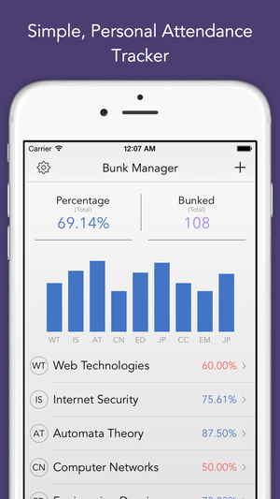
introduction
Bunk manager is an attendance management application.
It is student friendly.
It helps in maintaining a work - life balance, and prioritizing subjects.
It calculates attendance in a systematic manner, with the respective attendance cut-off.
Absenteeism is inevitable, but managing it properly can do wonders.

Slide 4
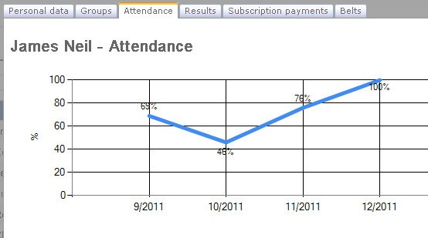
statistics

Slide 5
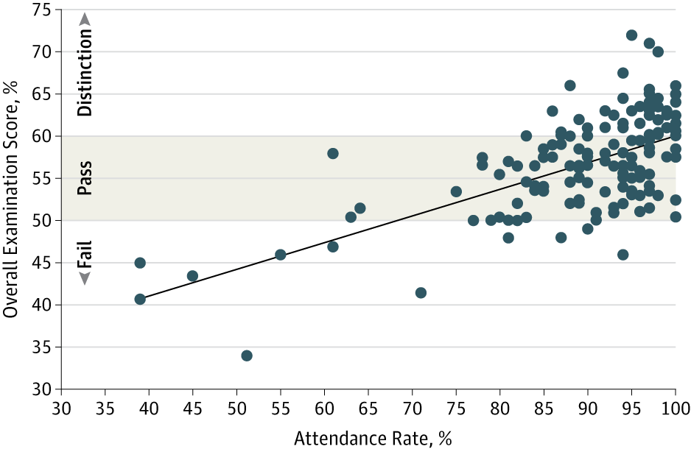
statistics
Major studies show, attendance directly influences academic performances.
It also influences drop out rates.
Attendance in the ug levels, fall in a drastic fashion, hence affecting grades and knowledge.
At this point, bunk manager is an ideal app to, calculate and attend classes in a systematic manner, hence maximising grades.

Slide 6
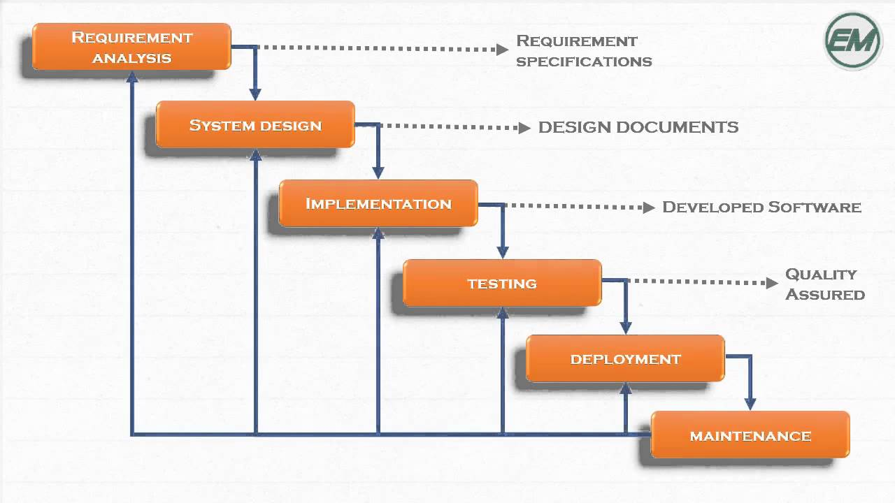
Waterfall model

Slide 7

System requirements
The minimum system requirements are:
CPU: Intel i3, 5th Gen.
OS: Window 07, Ubuntu 16.0.4
FREE DISK SPACE: 50mb

Slide 8

Research and findings
This project, calculates the effective Attendance of a student at a particular time. The formula for calculation of Attendance used is:
(No. of classes attended/No. of classes conducted)*100
This in turn, is compared to the required percentage, and tells, the amount of safe bunks available.

Slide 9
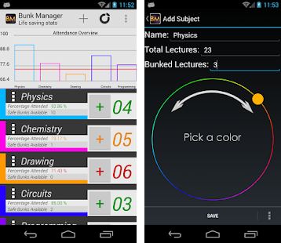
Input and output
The coding in this project will be carried out in c++.
The inputs asked by the application are as follows:
Name of the Subjects in their course.
Number of classes conducted in each subject.
Number of classes attended in each subject.
Desired attendance (Default 75%).

Slide 10
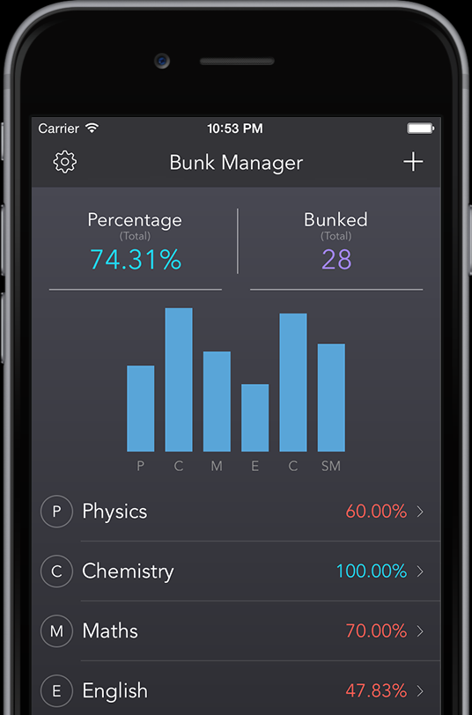
Input and output
The outputs for the applications are as follows:
Subject-wise attendance of the student.
Total attendance of student.
Number of safe bunks available, with respect to the minimum attendance cut-off.

Slide 11

Conclusion
Bunk manager is a student friendly app, which helps prioritize subjects and manage attendance.
Studies show, bad effect of absenteeism on academic performance.
The application, uses formulae's to calculate and analyse attendance.
It takes inputs about certain data, analyses it, performs operations and gives sensible outputs.
It is a great application, to manage attendance and maximise knowledge.

Slide 12
THE END
THANK YOU
BY:
AYUSH SINGH-1604-17-737-022
SAMARTH SHETTY:1604-17-737-025
PRANAV HINDUPUR:1604-17-737-004

